Slide 1
OWASP DEMO
Name: Chee Wei Long
Practical Grp: PC 02
Youtube Link: https://youtu.be/D3bRR08nVg4

Slide 2
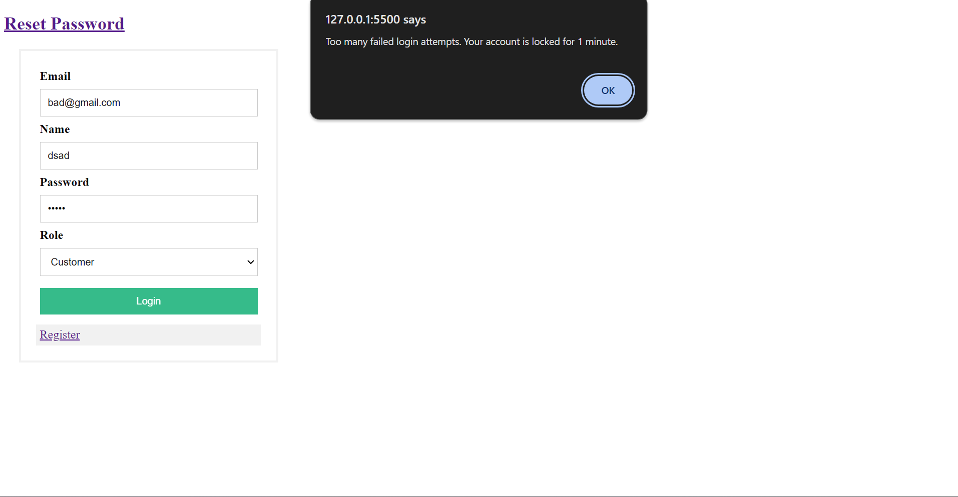
OWASP #1
API2:2023 Broken Authentication https://owasp.org/API-Security/editions/2023/en/0xa2-broken-authentication/
Vulnerability : Permits attackers to perform a brute force attack on the same user account, without presenting captcha/account lockout mechanism.
Lockout protections
Demo/Explain the new security feature

Slide 3
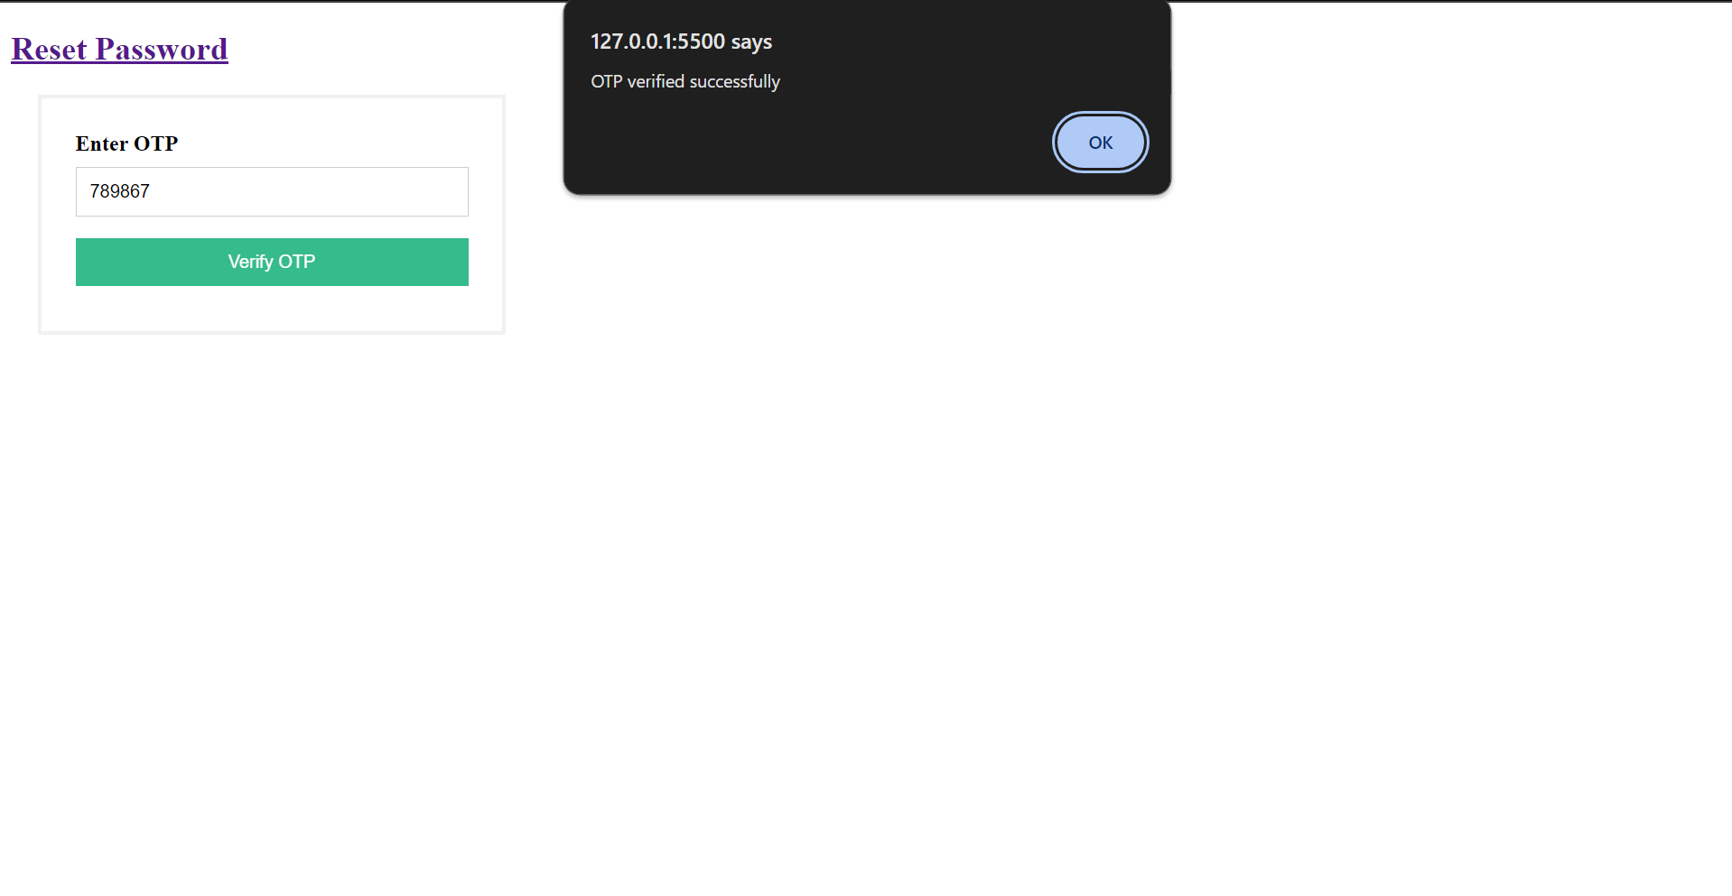
OWASP #2
https://cheatsheetseries.owasp.org/cheatsheets/Multifactor_Authentication_Cheat_Sheet.html
Vulnerability : Proper OTP implementation can help ensure that only authorized users access sensitive resources.

Slide 4
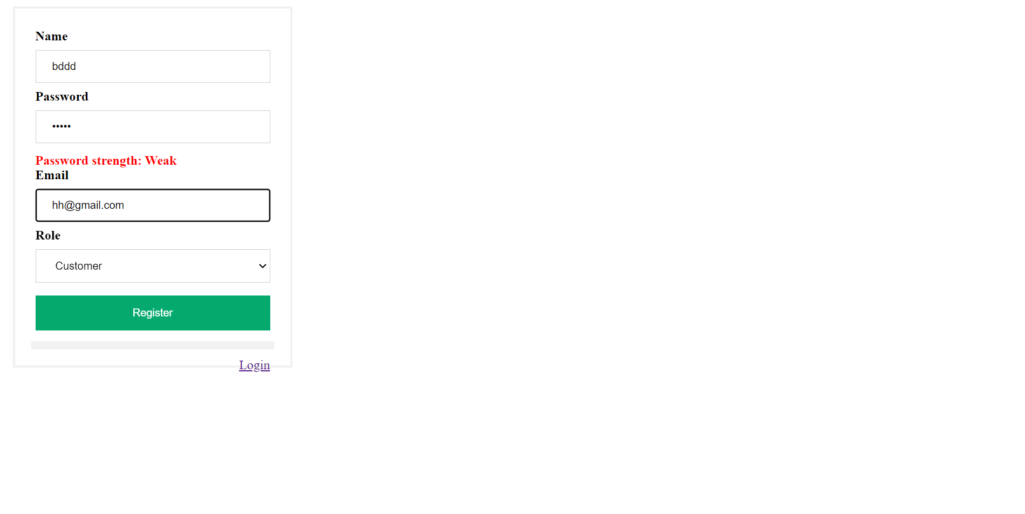
OWASP #3
https://owasp.org/API-Security/editions/2023/en/0xa2-broken-authentication/
Vulnerability : Permits weak passwords.

